Slide 1
Video Product Update
Chad Raymond

Slide 2
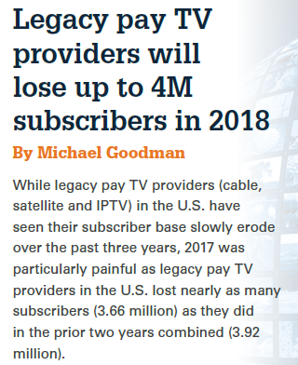
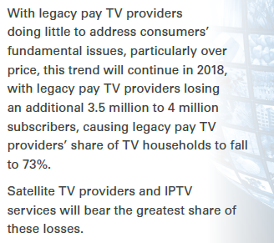
Fierce Video Predictions: 2018 and Beyond
This Trend Should Terrify
Big Pay-TV Companies
Adam Levy at The Motley Fool
Aug 26, 2018

Slide 3
Agenda
4K Content
OTA Direct Feeds
IPTV Converted
Streaming Services
Survey

Slide 4
4K Content
SES platform is active in our lab
Around a dozen channels from a few different content providers
Throughput rates between 12-25 Mbps

Slide 5
4K Content
What’s available in the broadcast marketplace?
DirecTV
Ultimate or Premier package; or $4 to $16 per title On Demand
Dish
Live packages start at $40 or $8 per title On Demand
Epix service added in Aug. 2018 for $7 monthly
Supports Netflix 4K
Comcast
Free to Xfinity customers
Mostly NBCU content
Supports Netflix or included with some packages
Here’s how and where you can watch the best 4K content
Kris Wouk at Digital Trends
Aug 10, 2018
4K

Slide 6
4K Content
What’s available in the streaming marketplace?
Netflix
Upcharge
25 Mbps internet recommended
All major original series +
Amazon
Included with Prime Annual
Most original series +
Much HDR
Other players
iTunes, Vudu, YouTube, UltraFlix, Sony Playstation, Sony Ultra, Fandango Now, Google Play, fuboTV
Here’s how and where you can watch the best 4K content
Kris Wouk at Digital Trends
Aug 10, 2018
4K

Slide 7
OTA Direct Feeds
Aureon currently has one direct feed for over-the-air broadcasters
Taking a fresh look at the costs involved in getting more direct feeds
Looking at multiple DMAs
Still the most-watched channels
OTA

Slide 8
IPTV Converted
“IPTV Converted” is taking the current Aureon IPTV signal and converting it for use with different kinds of deployments
Currently, there is one System Operator converting the DET IPTV signal into RF for use on coax (all of the conversion is done at the System Operator’s CO)
Aureon is planning to relaunch this offering and researching:
Marketplace demand
Equipment available for conversion (RF and QAM/MPEG-2)
Aureon might provide an MPEG-2 analog signal for most of the client’s lineup
Client could then convert any remaining channels that are needed at the edge
This would greatly reduce the equipment needed at the edge, but require greater transport
Which channels would most ITCs need?

Slide 9
IPTV Converted
IPTV System Operators may be able to utilize this signal to offer service where a STB is not feasible
Multiple dwelling units
Hotels
Nursing homes
IPTV

Slide 10
IPTV Converted vs Streaming
Open Question – Instead of offering an IPTV Converted option, should Aureon focus on offering a streaming service that could replace traditional analog / QAM deployments?
Analog requires no STB
Will ITCs’ communities embrace using Roku, Amazon Fire, etc. devices for their subscription TV?
Would this work well for MDU, etc.?
IPTV

Slide 11
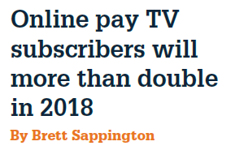
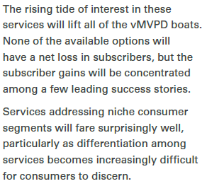
Fierce Video Predictions: 2018 and Beyond
excerpt

Slide 12
Streaming Services
Offer an adaptive bit rate signal?
Offer a full platform?
MobiTV?
Harmonic?
Innovative?
Partner with another headend?

Slide 13
Fierce Video Predictions: 2018 and Beyond
excerpts

Slide 14
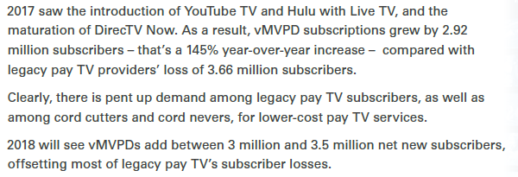
Fierce Video Predictions: 2018 and Beyond
excerpt

Slide 15
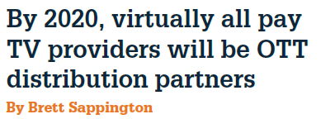
Fierce Video Predictions: 2018 and Beyond
excerpt

Slide 16
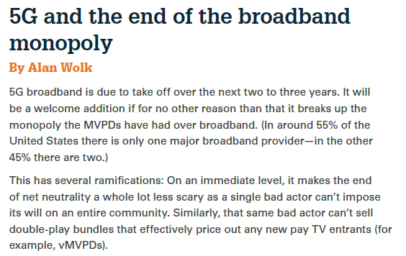
Fierce Video Predictions: 2018 and Beyond
When Is 5G Coming to the US? (Updated for 2018)
Tim Fisher at Lifewire
Sept 4, 2018

Slide 17
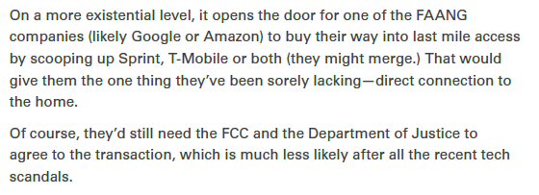
Fierce Video Predictions: 2018 and Beyond
When Is 5G Coming to the US? (Updated for 2018)
Tim Fisher at Lifewire
Sept 4, 2018

Slide 18
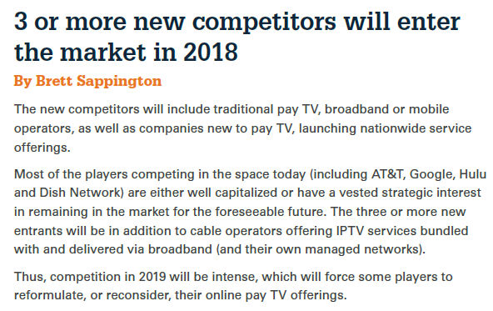
Fierce Video Predictions: 2018 and Beyond
52 percent of U.S. broadband households subscribe to both pay TV and one or more OTT video services
Gary Arlen at TV Technology
July 10, 2018

Slide 19
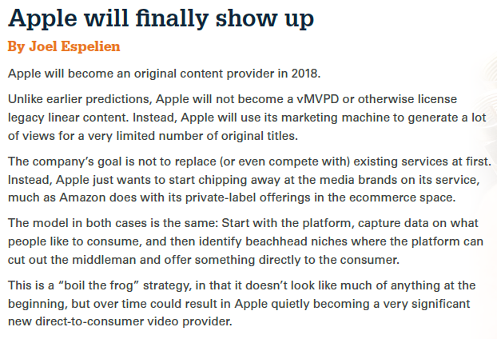
Fierce Video Predictions: 2018 and Beyond
Stream of Articles about Apple’s new video content
Verge Staff at The Verge
Last updated Aug 23, 2018

Slide 20
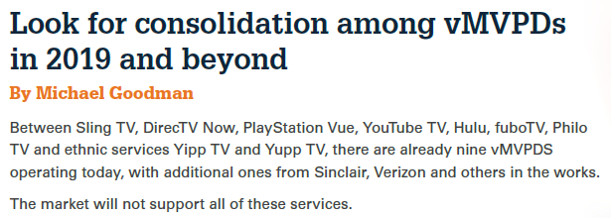
Fierce Video Predictions: 2018 and Beyond
vMVPDs Are Getting More Expensive; Here's Why Consumers Might Be OK With That
Alan Wolk at Forbes
June 30, 2018

Slide 21
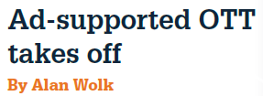
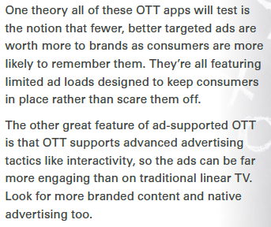
Fierce Video Predictions: 2018 and Beyond
Ad-Supported OTT Keeps Growing, And Advertisers Would Be Wise To Take Note
Alan Wolk at Forbes
July 26, 2018
excerpt

Slide 22
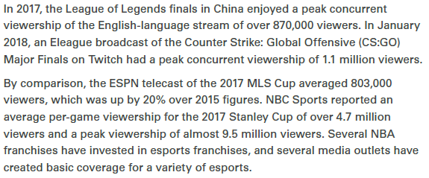
Fierce Video Predictions: 2018 and Beyond
Here's what the CEOs of the biggest gaming companies are saying...
CNBC's Eric Chemi on Activision and Take Two Interactive earnings. With CNBC's Scott Wapner and the Fast Money traders, Tim Seymour, Karen Finerman, Dan Nathan and Guy Adami.
Aug 2, 2018
excerpt

Slide 23
ITCs have the Answers
Aureon has questions and ITCs have the answers
ITCs will receive a DET Product Survey the afternoon of Thurs, Sept 13
We’ll ask about:
4K
IPTV Converted
Streaming services
Your feedback is crucial to the future success of this product

Slide 24
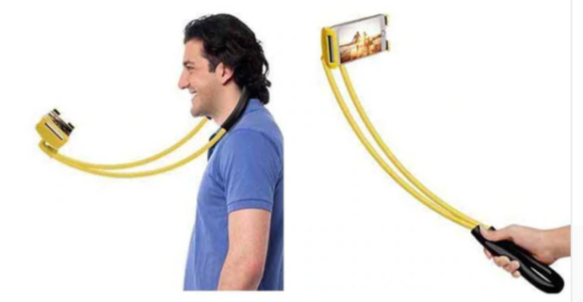
Fierce Chad Predictions: 2018 and Beyond
Lazy Neck
Phone Holder

Slide 25
– Questions –

Slide 26
Chad Raymond
Chad.Raymond@Aureon.com
515-830-0367

