Slide 1

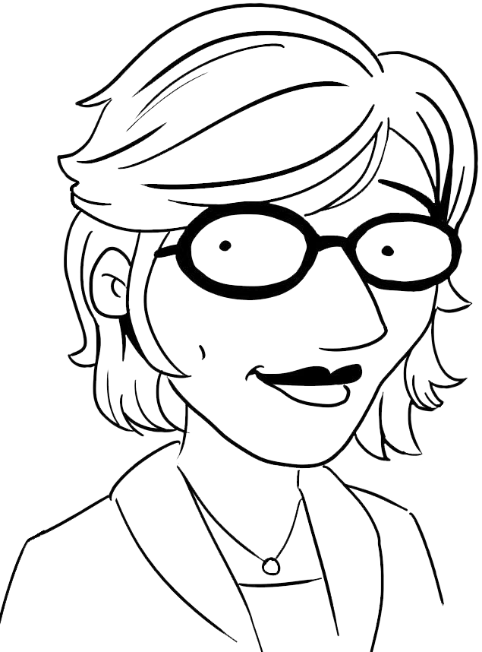

From Order Taker to Taking Orders
Coaching for performance
www.SarahNollWilson.com

Slide 2
WHAT IS COACHING?

Slide 3
Through deep listening and thoughtful questions you help the other person:
Increase self awareness
Explore possibilities, and
Take inspired action

Slide 4
Mastery
Autonomy
Purpose

Slide 5

CORE SKILL: DEEP LISTENING

Slide 6




FOCUS ON SELF
What does this mean to me?
FOCUS ON OTHERS
What does this mean to them?

Slide 7
What did you hear your partner values?
What did you hear are your partner’s strengths?

Slide 8
CORE SKILL: PROVOCATIVE QUESTIONS

Slide 9
QUESTION TRAPS
1
Closed ended questions

Slide 10
QUESTION TRAPS
Solution oriented questions
2

Slide 11
QUESTION TRAPS
3
Why

Slide 12
G.R.O.W.
G.R.O.W.

Slide 13
What does success look like for you?
What do you want the outcome to be?
G
GOAL
What’s the impact you want to make?
What best case scenario?

Slide 14
What do we know to be true?
What information do we need to gather?
R
REALITY
What’s your perspective?
What makes sense to the other person?

Slide 15
What are your options?
What are possible places to start?
O
OPTIONS
If you were in my shoes what would you do?
Let’s come up with 3-5 ideas

Slide 16
What do you commit to doing differently?
What will you do?
W
WILL
What support do you need to help you accomplish this?
What are your next steps?

Slide 17

Notes:
Great leaders take accountability for their intended and unintended impacts. By being more curious about ourselves and others we can close the gap between our intention and our impact. And help others do the same. Go forth and be chronically curious.

Slide 18



Sarah Noll Wilson, Inc.
@sarahnollwilson
www.sarahnollwilson.com
VISIT ONLINE TO LEARN MORE!

