Slide 1


Transforming
the workforce THRU EDUCATION
Closing
Iowa’s
skills gap

Slide 2
Iowa
Unemployment Rate – November
Current
unemployment rate
2.6%
1,757,900 Iowans in the workforce
Unemployed Persons
46,200
Source: Local Area Unemployment Statistics, BLS

Slide 3
strategy
Last Dollar Scholarship
For Iowans seeking up to an associates degree in a high-demand job at Iowa colleges or universities.
Funded at $13 million in FY20
Future Ready Iowa Grant Program
For Iowans seeking a bachelor’s degree who already earned more than half the credits for a major in a
high-demand job.
Funded at $1 million in FY20
Employer Innovation Fund
For public/private partnerships to grow the regional talent pipeline.
Funded at $1.2 million in FY20
$
All three strategies incorporated in Future Ready Iowa Act signed April 4, 2018 and funded as provided in HF758, HF 546 and SF 608, signed May 2019

Slide 4
Last Dollar Scholarship
Funds postsecondary credentials up to an associates degree in high-demand occupations. ($13,044,744)
Target High School graduates and adults – this can be used to upskill adult employees;
Not income means tested – focus on providing more opportunities for Iowans to gain needed skills to fill high demand jobs to meet Iowa’s workforce needs.
As employers with open occupations on the high demand list, you can leverage this funding for your current employees

Slide 5
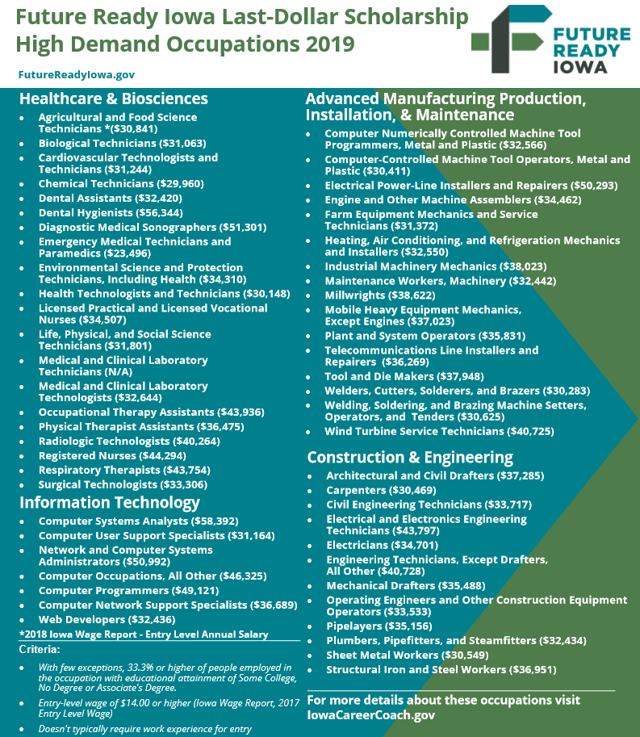

Slide 6
Future Ready Iowa Grant Fund
  Intended to encourage Iowans who left college with at least half the credits required for a bachelor’s degree in a high-demand field of study to return and complete.
  Stipend to help cover tuition, currently $3,500.00
  $1,000,000 appropriated

Slide 7
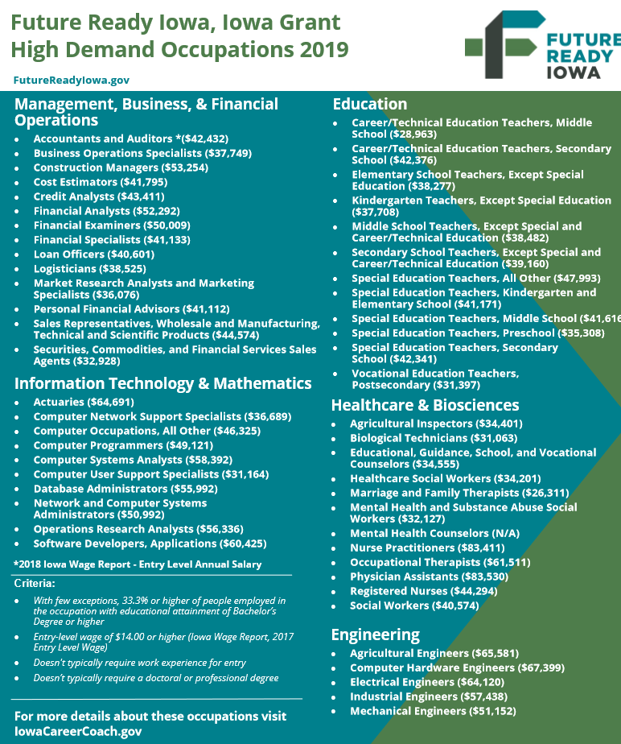

Slide 8
Employer Innovation Fund
  Designed to encourage employers, community leaders and other stakeholders to identify local needs, develop local plans to resolve; raise local funds to support.
  Local investment is then matched by the state for successful applicants.
  FOCUS is addressing barriers beyond tuition and fees, supporting non-credit programs
  Encourages creative and innovative local solutions
  $1,200,000 appropriated in 2019
  NEXT APPLICATION DEADLINE – November 8, 2019
  Iowagrants.gov

Slide 9
strategy
Expand Work-based Learning Experiences in
High-demand Careers; increase career development in middle and high school
Quality pre-apprenticeships
Registered apprenticeships
Internship programs
Leverage existing programs, such as the STEM BEST (Businesses Engaging Students and Teachers) program and Iowa (Work-Based Learning) Intermediary Networks
Launched WBL Clearinghouse in July 19

Slide 10
Registered
Apprenticeship in High schools
Iowa has 13 High Schools with Active Registered Apprenticeships
Winterset Community School District
North Scott High School
Davenport Community School District
Pella Career Academy
Iowa Edge/ Boone High
West Delaware Community School District
Central Campus Des Moines Public Schools
Greene County Community School District (North Central Career Academy)
Clinton Community School District
Clear Lake Community School District
Muscatine High School
West Des Moines Community School District
Nevada Community School District

Slide 11
Quality Pre-Apprenticeship Programs in High Schools/Employers
Des Moines Lincoln High School
North Scott High School
Davenport Community Schools
Central Campus
IJAG
Boone High School
Spencer High School
Plumbers and Pipefitters Local 33
Waverly Shell Rock High School
Van-Wall Equipment
NewBoCo
Dubuque Senior High School
Hempstead High School
Keokuk High School
Red Oak High School
Cedar Rapids Community School District
Tri-Center Community School District

